Slide 1
AP Biology Intro to Statistics

Slide 2
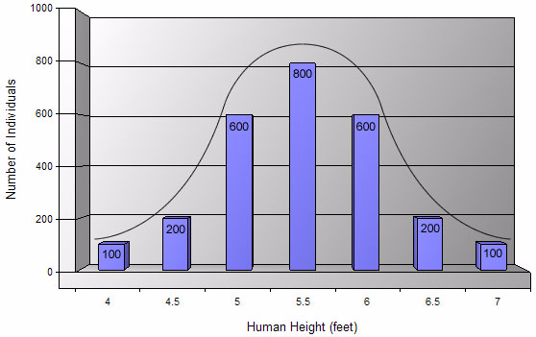
Statistics
Statistical analysis is used to collect a sample size of data which can infer what is occurring in the general population
Typical data will show a normal distribution (bell shaped curve).

Slide 3
Statistical Analysis
Two important considerations
How much variation do I expect in my data?
What would be the appropriate sample size?

Slide 4
Measures of Central Tendencies
Mean
Average of data set
Median
Middle value of data set
Not sensitive to outlying data
Mode
Most common value of data set

Slide 5
Analyzing your data
You conducted an experiment to see if the variable you added had any impact on plant growth
Null hypothesis- Adding the variable will have NO impact on plant growth
Alternate Hypothesis- Adding your variable will increase the growth rate of the plants

Slide 6
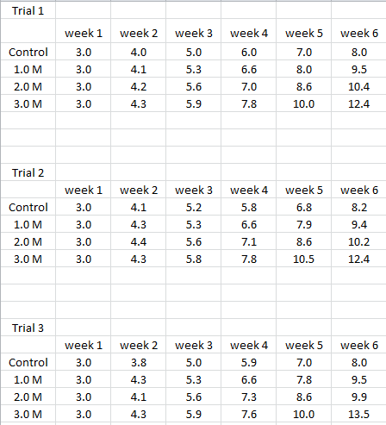
Analyzing your data
It appears like there is an increase in growth compared to that of the control…BUT we need to be sure
What increase in growth is SIGNIFICANT?? 1 extra cm? 10 cm?

Slide 7
Analyzing your data
First we have to figure out what is “normal”
Ie) what do we expect to happen without the addition of your variable?
This will be your control. You have 3 trials each with 3 samples…average those 9 samples
Ie) Find the mean

Slide 8
Measures of Average
Mean: average of the data set
Steps:
Add all the numbers and then divide by how many numbers you added together
Example: 3, 4, 5, 6, 7
3+4+5+6+7= 25
25 divided by 5 = 5
The mean is 5

Slide 9
Analyzing your data
You now have a number that represents the average growth of your control plants
We need to compare that value to the mean average of the samples that had the variable added
We need to see how far the values deviate (are different from) from that of the control

Slide 10
Measures of Variability
Standard Deviation
It shows how much variation there is from the mean.
In normal distribution, about 68% of values are within one standard deviation of the mean
Often report data in terms of +/- standard deviation
If data points are close together, the standard deviation with be small
If data points are spread out, the standard deviation will be larger

Slide 11
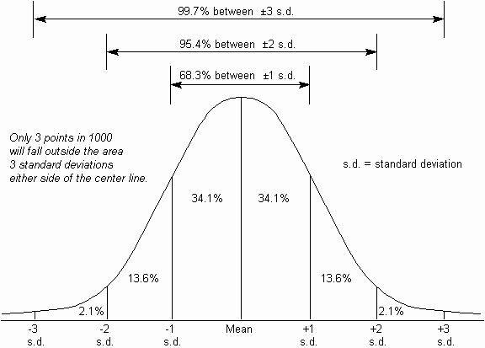
Standard Deviation
1 standard deviation from the mean in either direction on horizontal axis represents 68% of the data
2 standard deviations from the mean and will include ~95% of your data
3 standard deviations form the mean and will include ~99% of your data
Bozeman video: Standard Deviation

Slide 12
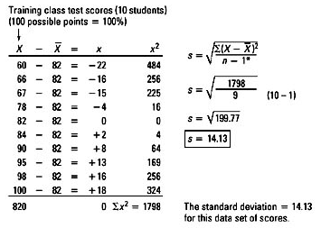
Calculating Standard Deviation
14.13
14.13
Mean = 82
The majority of the values (68%) fall within 1 standard deviation of the mean (+/- 14.13)

Slide 13
Calculating Standard Deviation
Grades from recent quiz in AP Biology:
96, 96, 93, 90, 88, 86, 86, 84, 80, 70
1st Step:
find the mean (X)
Measure Number | Measured Value x | (x - X) | (x - X)²
1 | 96 | 9 | 81
2 | 96 | 9 | 81
3 | 92 | 5 | 25
4 | 90 | 3 | 9
5 | 88 | 1 | 1
6 | 86 | -1 | 1
7 | 86 | -1 | 1
8 | 84 | -3 | 9
9 | 80 | -7 | 49
10 | 70 | -17 | 289
TOTAL | 868 | TOTAL | 546
Mean, X | 87 | Std Dev

Slide 14
Calculating Standard Deviation
2nd Step:
determine the deviation from the mean for each grade then square it
Measure Number | Measured Value x | (x - X) | (x - X)²
1 | 96 | 9 | 81
2 | 96 | 9 | 81
3 | 92 | 5 | 25
4 | 90 | 3 | 9
5 | 88 | 1 | 1
6 | 86 | -1 | 1
7 | 86 | -1 | 1
8 | 84 | -3 | 9
9 | 80 | -7 | 49
10 | 70 | -17 | 289
TOTAL | 868 | TOTAL | 546
Mean, X | 87 | Std Dev

Slide 15
Calculating Standard Deviation
Step 3:
Calculate degrees of freedom (n-1)
where n = number of data values
So, 10 – 1 = 9
Measure Number | Measured Value x | (x - X) | (x - X)²
1 | 96 | 9 | 81
2 | 96 | 9 | 81
3 | 92 | 5 | 25
4 | 90 | 3 | 9
5 | 88 | 1 | 1
6 | 86 | -1 | 1
7 | 86 | -1 | 1
8 | 84 | -3 | 9
9 | 80 | -7 | 49
10 | 70 | -17 | 289
TOTAL | 868 | TOTAL | 546
Mean, X | 87 | Std Dev

Slide 16
Calculating Standard Deviation
Step 4:
Put it all together to calculate S
S = √(546/9)
= 7.79
= 8
Measure Number | Measured Value x | (x - X) | (x - X)²
1 | 96 | 9 | 81
2 | 96 | 9 | 81
3 | 92 | 5 | 25
4 | 90 | 3 | 9
5 | 88 | 1 | 1
6 | 86 | -1 | 1
7 | 86 | -1 | 1
8 | 84 | -3 | 9
9 | 80 | -7 | 49
10 | 70 | -17 | 289
TOTAL | 868 | TOTAL | 546
Mean, X | 87 | Std Dev | 8

Slide 17
Calculating Standard Deviation
So for the class data:
Mean = 87
Standard deviation (S) = 8
1 s.d. would be (87 – 8) thru (87 + 8) or 81-95
So, 68.3% of the data should fall between 81 and 95
2 s.d. would be (87 – 16) thru (87 + 16) or 71-103
So, 95.4% of the data should fall between 71 and 103
3 s.d. would be (87 – 24) thru (87 + 24) or 63-111
So, 99.7% of the data should fall between 63 and 111

Slide 18
Measures of Variability
Standard Error of the Mean (SEM)
How accurate is the mean
Accounts for both sample size and variability
Used to represent uncertainty in an estimate of a mean
As SE grows smaller, the likelihood that the sample mean is an accurate estimate of the population mean increases

Slide 19
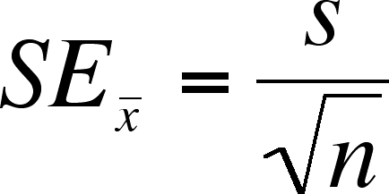
Calculating Standard Error
Using the same data from our Standard Deviation calculation:
Mean = 87
S = 8
n = 10
SE_{X} = 8/ √10
= 2.52
= 2.5
This means the measurements vary by ± 2.5 from the mean
Bozeman video: Standard Error

Slide 20
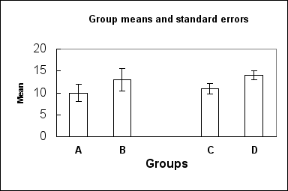
Graphing Standard Error
Common practice to add standard error bars to graphs, marking one standard error above & below the sample mean (see figure below). These give an impression of the precision of estimation of the mean, in each sample.
Which sample mean is a better estimate of its population mean, B or C?
Identify the two populations that are most likely to have statistically significant differences?

Slide 21
Graphing your data
The graph should visually summarize what your experiment was trying to show
Graph the mean heights of your control and different concentrations of variable
Bar graph will work well
Be sure to show the error intervals for each sample type

Slide 22
Hypothesis Testing
As was mentioned…the null hypothesis was that the addition of the variable would have no effect on plant growth
ie) the mean growth of each concentration should be the same as the mean growth of the control

Slide 23
Student’s T-test
To test the null hypothesis that 2 means are statistically equal (or if there is variation it is due to chance)

Slide 24
Student’s T-test
First we need to establish what our confidence level (error rate) should be…95%? 99%?
We usually go with 95% for biology (α=0.05). If you were testing a new part for an airline you may want to do 99% (α=0.01).

Slide 25
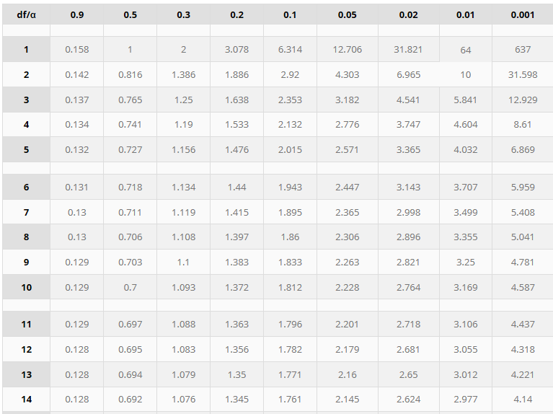
Student’s T-test
Once you plug all the numbers into the t-test formula you will get a value. Use α=0.05 and degrees of freedom, df, (n-1) to determine where your t value falls on the table
Lets say we had 9 plants. Df = 9-1=8
If our t-value calculate was 3.012 it would be above 2.306 and therefore outside the 95% range
The value shows that the mean of the variable was significantly different than that of the mean of the control (“we are more than 95% confident that the data does not match that of the control
However, it wouldn’t have been “different enough” to be 99% confident

